Slide 1
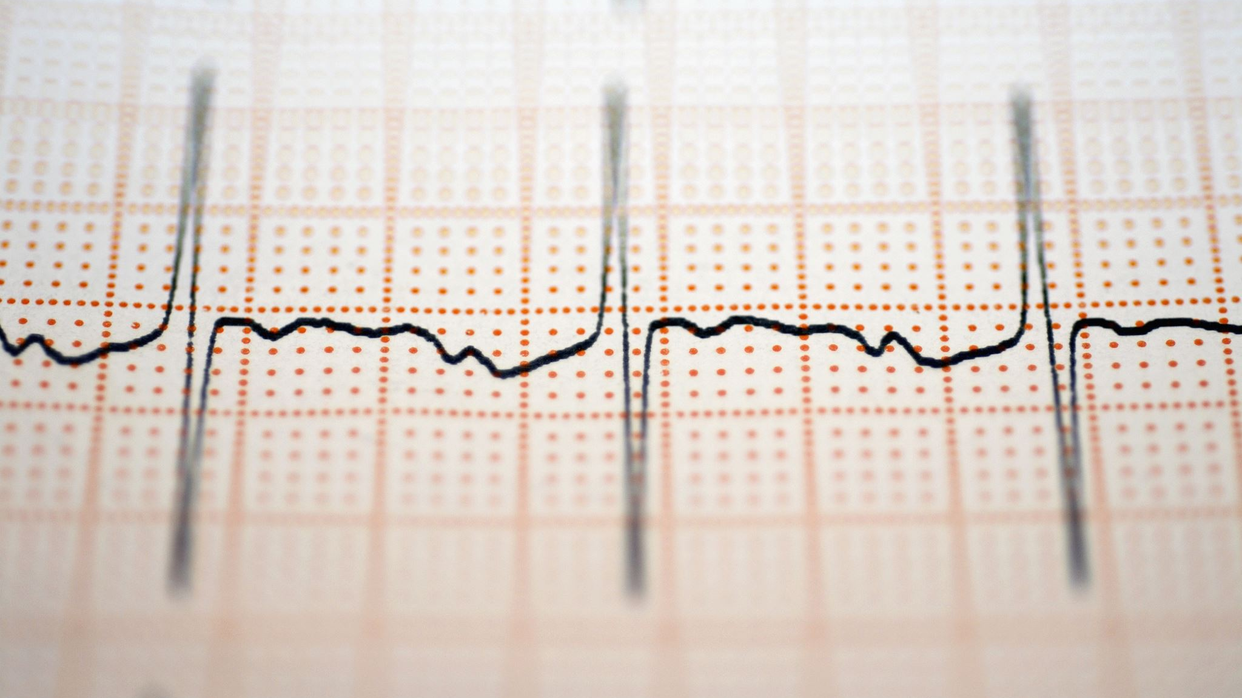
Halfway presentation: Fourier Analysis in Optical Coherence Tomography
Saban Caliskan

Slide 2

Goal:
Measuring width of Sub-nanometer particles, using Fourier.

Slide 3
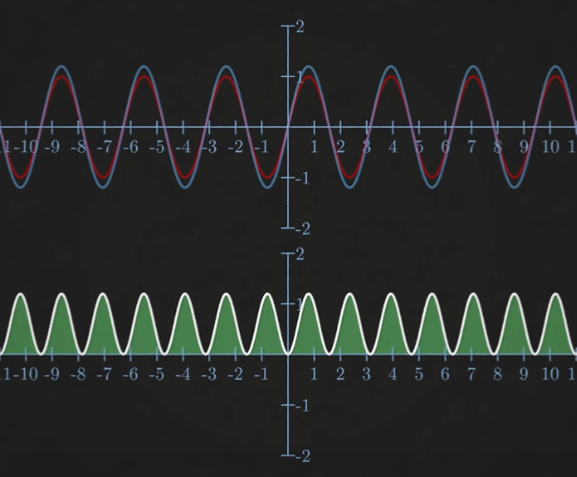
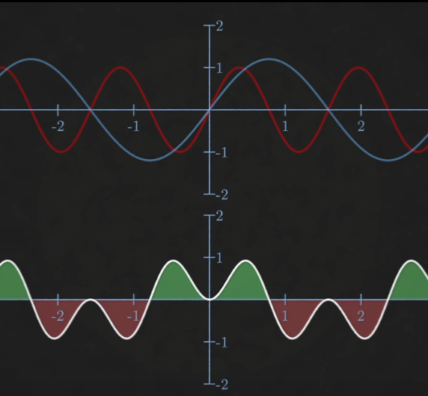
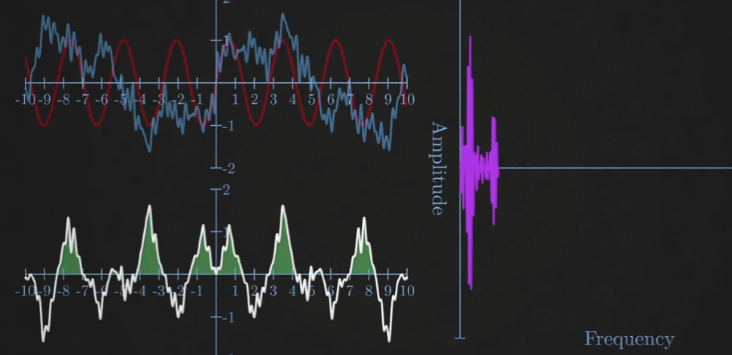

What is a Fourier Transform?
Frequencies through multiplication with e$i2πft$
Works for multiple frequencies.
Size of area gives the relative Amplitude
But our data set is discrete: DFT

Slide 4
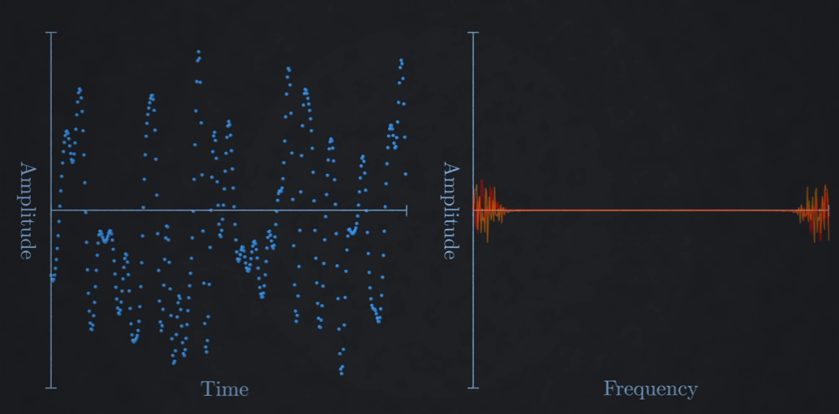
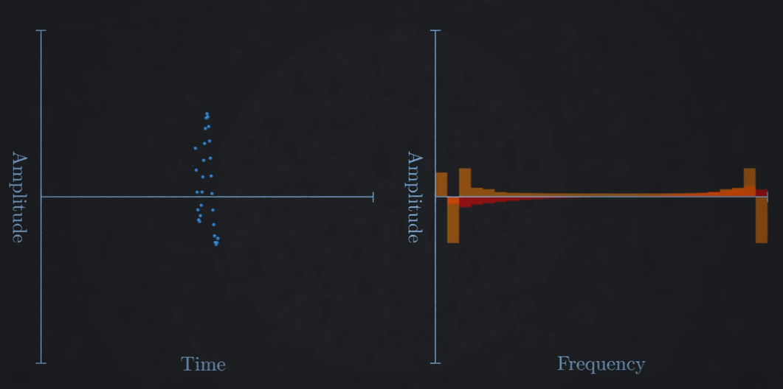
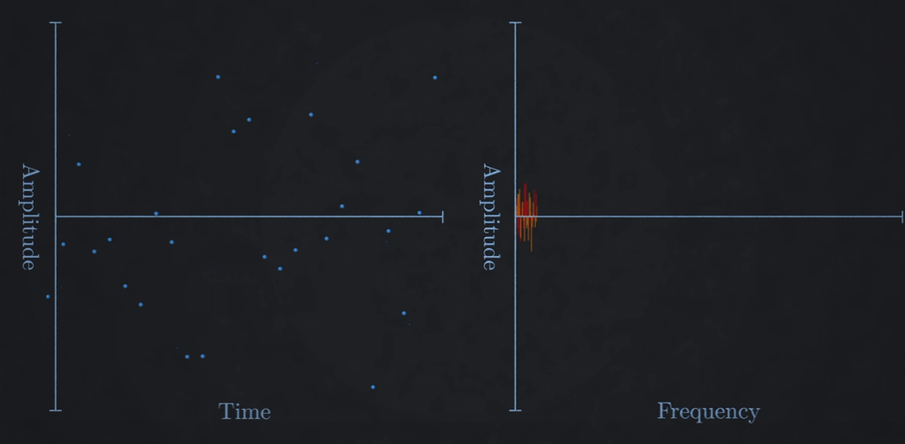
Discrete Fourier Transform
Frequency spectrum is also finite and discrete.
Multiply every point by all possible frequencies.
Number of frequencies = number of datapoints
Short duration -> bigger bins
Lower density of datapoints -> lower frequency.
Requires N² computation!

Slide 5

Fast fourier Transform
Because of properties we don’t have to do all calculations!
the amount of computations becomes Nlog₂(N)
Much faster for high amount of N datapoints.

Slide 6

How do we fit a peak?
What if the actual frequency does not fall in the centre of a bin?
We compared 4 methods to find/interpolate the peaks.
Quadratic
Barycentric
Jains
Quinns2nd
All the methods look at the highest value and interpolate using the values beside it.
In short:
M

Slide 7
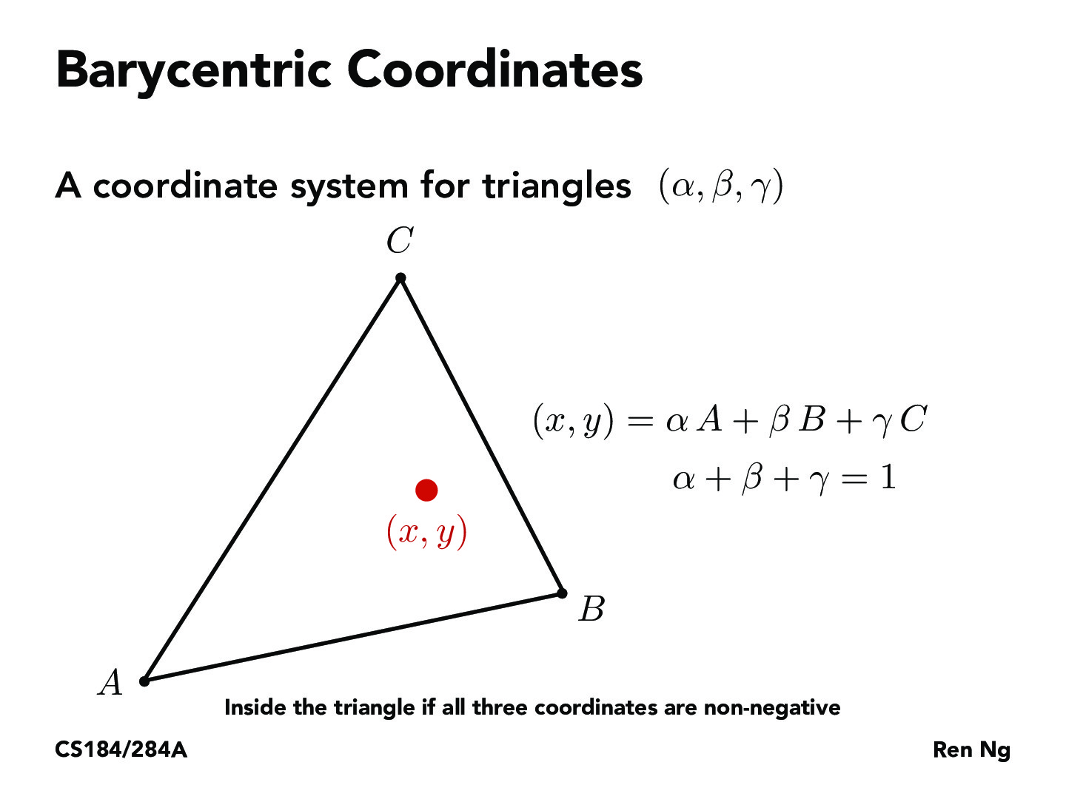
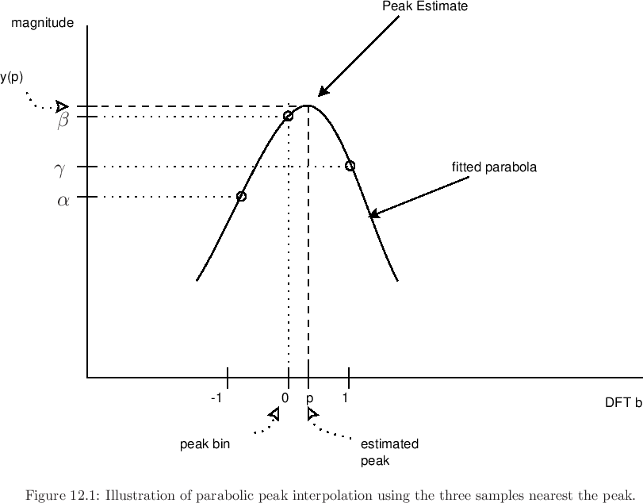
Methods:
In short and not in depth:
Quadratic method: finds the location of the peak using an offset based on the the quadratic equation/ tip of a parabola.
Barycentric method: finds the location using an offset which is equal to the centre mass point like a triangle.
Jains method: looks at which side is higher and determines an offset using the relative difference between the highest and second highest point.
Quinn’s 2nd method: creates an offset by generating 2 (big) complex numbers using the values from the bins next to the maximum and the maximum.

Slide 8
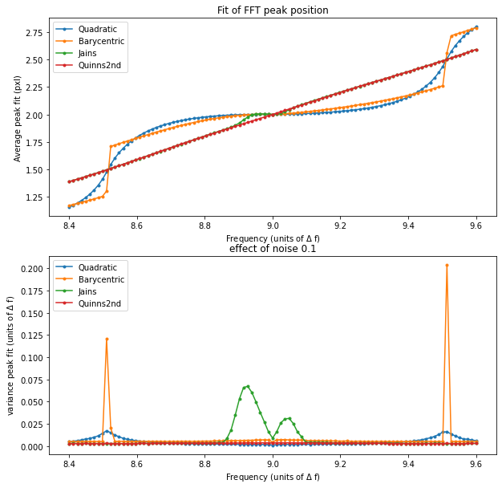
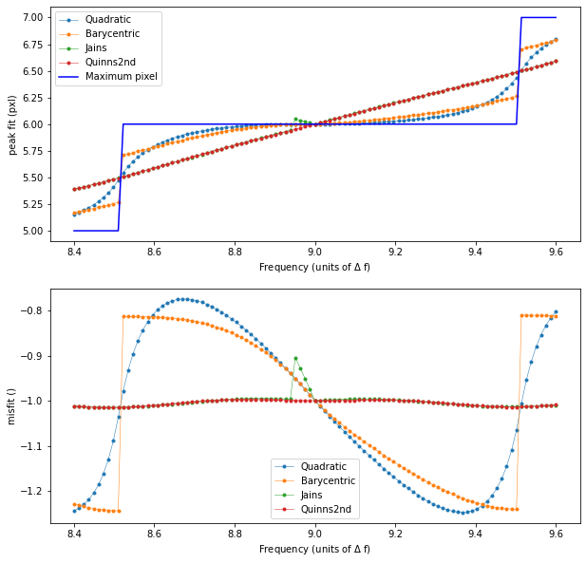
Best methods:
As you can see quadratic and barycentric methods have the biggest deviation.
Sadly the other two methods, even though they perform much better, aren’t continious.

Slide 9
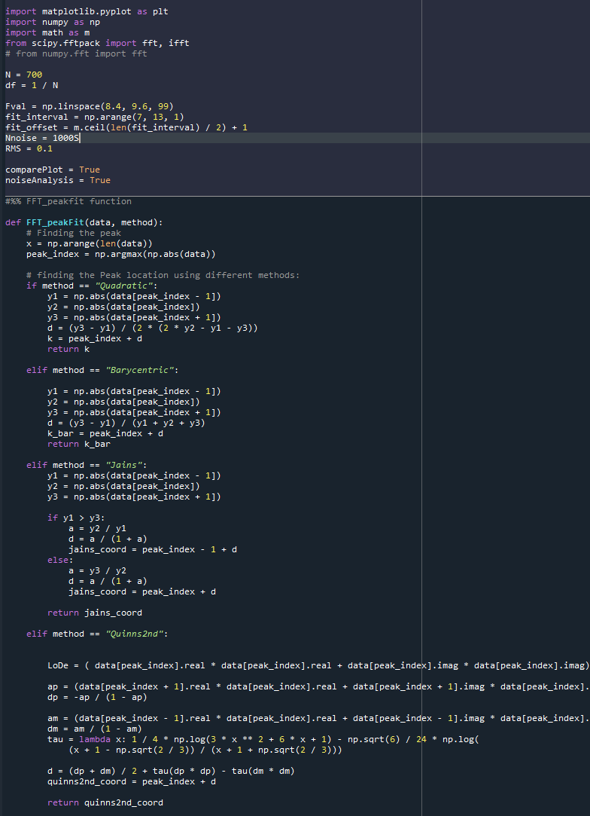
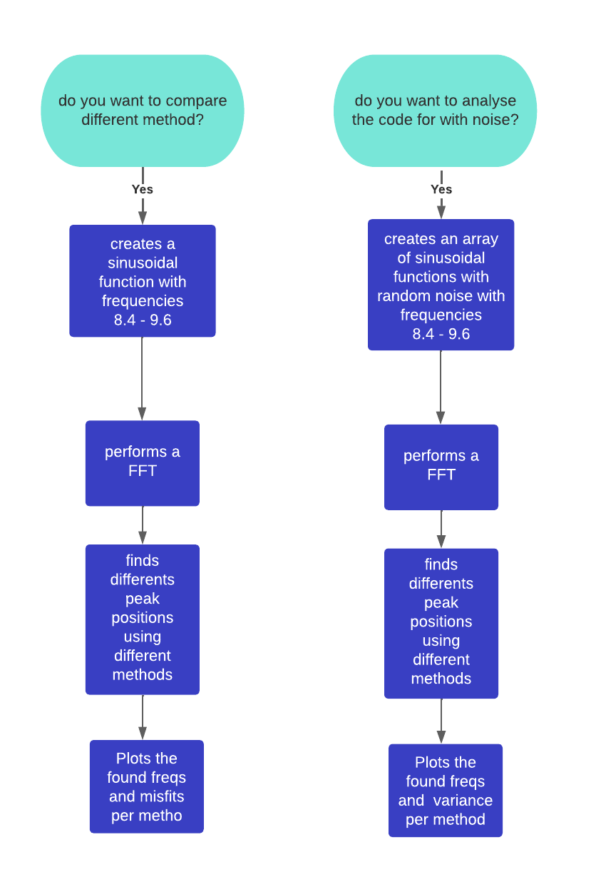
Our code
Currently
Algorithm
Goal:

